Slide 1





HackOrbit 2025
ResQTech

Slide 2

Theme - Sustainability
Problem Statement:-
DisasterSheild - Integrating Edge AI, Blockchain, and IoT for Autonomous Disaster Resilience and Rapid Response.

Slide 3
PROPOSED SOLUTION:-
We propose “DisasterShield”, an AI-powered, decentralized disaster management system that leverages Edge AI, and Blockchain to predict, alert, help and coordinate emergency responses autonomously. Our solution ensures faster disaster detection, real-time communication, and optimized resource allocation, minimizing damage and casualties.
🔹 Edge AI and IoT enable real-time disaster prediction using sensors, satellite data, and machine learning for proactive response.
🔹 Blockchain ensures secure, decentralized communication between agencies, NGOs, and responders for efficient coordination.
🔹 AI-driven resource management optimizes the allocation of rescue teams, medical aid, and relief supplies.
🔹 A Web platform provides emergency protocols, evacuation plans, and AI-powered training for public safety.

Slide 4
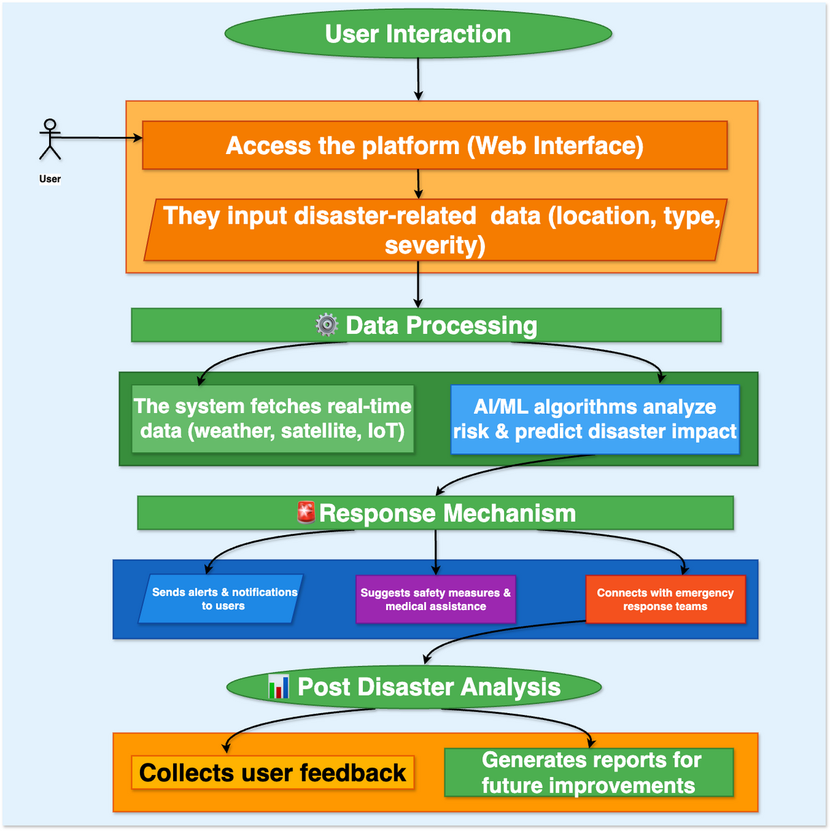
FLOWCHART/DIAGRAM:-

Slide 5
FLOWCHART/DIAGRAM (Explanation):-
1. User Interaction:-
Users access the platform via a web interface.
They input disaster-related details:
Location 📍, Type of disaster (earthquake, flood, wildfire), Severity level.
2. Data Processing:-
The system fetches real-time data from sources like:
Weather APIs (OpenWeather), Satellite images, IoT sensor readings.
AI/ML algorithms analyze:
Risk levels ,Potential disaster impact.
3. Response Mechanism:-
The system sends real-time alerts 📢 (SMS, notifications).
Provides safety measures & medical assistance recommendations 🏥.
Connects with emergency response teams 🚒 (fire, hospitals, rescue).
4. Post-Disaster Analysis:-
Collects user feedback to evaluate response effectiveness.
Generates reports 📊 to improve disaster preparedness.

Slide 6
FEATURES AND NOVELTY:-
📌 Features of DisasterShield:-
🔹AI-Powered Disaster Prediction without cloud dependency.
🔹Autonomous Emergency Response.
🔹Optimized Resource Allocation.
🔹Post-Disaster Recovery & Analytics.
🔹Blockchain-Based Transparency.
📌 Novelty of DisasterShield:-
🔹 Edge AI for Instant Decision-Making. ()
🔹 Smart Contracts for Automated Fund Allocation.
🔹 Real-Time, Community-Integrated Disaster Reporting.
🔹 AI-Driven Damage Assessment & Future Resilience Planning.

Slide 7
DRAWBACK AND SHOWSTOPPERS:-
📌 Drawbacks of DisasterShield:-
Data Privacy & Security Risks.
Internet & Power Dependency.
Limited Public Adoption.
🚨 Showstoppers for DisasterShield:-
Real-Time Data Processing Limitations.
AI Model Accuracy & Bias.
Regulatory & Government Compliance.

Slide 8
ResQTech
Team Member 1:-
Name - Harsh Sharma (Team Leader)
Contact details - Phone no. - 7089264826
E-mail - harsharma2029@gmail.com
Team Member 2:-
Name - Manav Jain
Contact details - Phone no. - 9109532030
E-mail - jmanav066@gmail.com

Slide 9
Thank you

